Slide 1

"Changing landscapes of Myeloma Treatments
And
The Role of Haematopoietic Stem Cells Transplantations,
In the era of Targeted and Immunotherapy”
New standard almost each year
A practical approach in 2019

Slide 2
Dr Amin Islam
MBBS, MRCP UK, FRCP London, FRCPath UK
Consultant Haematologist and BMT
Mid and South Essex & University College London Hospital NHS Foundation Trusts
Bart's and The London School of Medicine and Dentistry
Queen Mary University, London.

Slide 3
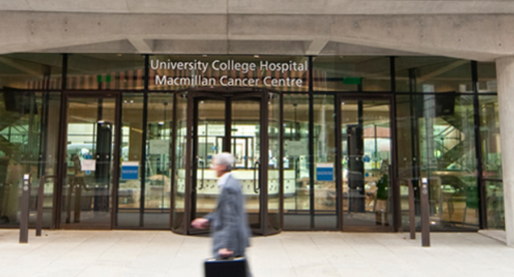


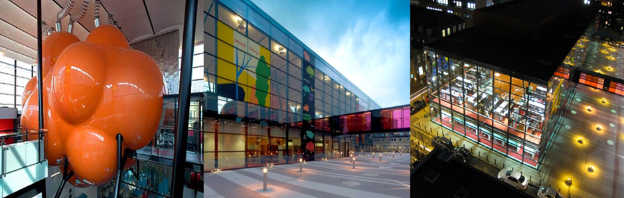

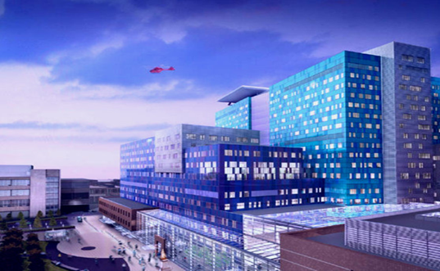
My affiliations

Slide 4
Conflict of interest
Conference attendance: Sponsored by the Oncology Club Dhaka

Slide 5
Plasma Cell Myeloma is still considered a single disease BUT
In reality a collection of several different cytogenetically distinct plasma cell malignancies

Slide 6
INTRODUCTION
Multiple myeloma 10% of all hematologic malignancies
Median age >70
30% younger then 65 and potentially transplant eligible
Treat when symptomatic OR
80% risk of progression to symptomatic end‐organ damage in two or more independent studies as below new risk groups
Clonal bone marrow plasma cells of 60%
Higher, serum free light chain (FLC) ratio of 100 or higher
More than one focal lesion on magnetic resonance imaging (MRI).

Slide 7
Goals of therapies
Finding optimal treatment strategies to
Improve long-term outcome
Minimizing the impact of treatment-related toxicity

Slide 11
Cytogenetic and Risk Group
Trisomies and IgH translocations are considered primary cytogenetic abnormalities and occur at the time of establishment of monoclonal gammopathy of undetermined significance (MGUS)
Secondary cytogenetic abnormalities
Occur during disease course
such as gain(1q), del(1p), del(17p),
del(13), RAS mutations, and secondary translocations involving MYC

Slide 12
High Risk
del(17p), gain(1q), t(4;14), t(14;16), and t(14;20)

Slide 13
MRD status and Treatment Decision
Recent data show that minimal residual disease (MRD)–negative status (as estimated by next‐generation molecular methods or flow cytometry) has favourable prognostic value
Await more data on the MRD status and tailoring treatments
MRD results are recommended mainly as a prognostic metric and not for use in making treatment decisions

Slide 14
Available Drugs for upfront use in Combinations
Survival of MM has improved significantly in the last 15 years
More than 22 FDA approved drugs available
Thalidomide, lenalidomide, and Pomalidomide are termed immunomodulatory agents (IMiDs)
Bortezomib, Carfilzomib, and Ixazomib are proteasome inhibitors ( PIs)
Panobinostat is a deacetylase inhibitor

Slide 15
Many more therapies are on the pipeline
Elotuzumab and Daratumumab are monoclonal antibodies targeting SLAMF7 and CD38, respectively.
Numerous regimens have been developed with these
Additional new regimens are being developed each year

Slide 16
INITIAL TREATMENT IN PATIENTS ELIGIBLE FOR TRANSPLANTATION
Typically
Patients are treated with approximately 3 to 4 cycles of
induction therapy with bortezomib, lenalidomide, and dexamethasone (VRd) prior to stem cell harvest (VTd in UK)
Low dose Dexamethasone are preferred 20mg 4 days or 40 mg Weekly
5. Rajkumar SV, Jacobus S, Callander NS, et al. Lancet Oncol. 2010;11(1):29‐37.

Slide 17
Alternatives
If lenalidomide is not available for use as initial therapy or in the presence of acute renal failure
Bortezomib‐containing regimens such as bortezomib thalidomide‐dexamethasone (VTd)
Or
Bortezomib‐cyclophosphamide‐dexamethasone (VCd) can be used instead of VRd.

Slide 18
ASCT as Consolidation
After harvest,
Patients can either undergo frontline autologous stem cell
transplantation (ASCT)
or
Resume induction therapy delaying ASCT until first relapse
As data are showing NO OS benefit in the Era of Newer therapies

Slide 19
New options for initial therapy in younger patients
Carfilzomib‐lenalidomide‐dexamethasone (KRd);
Daratumumab,lenalidomide, and dexamethasone (DRd);
Daratumumab plus VRd.
Additional data on impact of these regimens compared with
that of VRd are needed.
A randomized trial in the United States
(referred to as the Endurance trial) is currently on-going comparing
VRd versus KRd as initial therapy.

Slide 20
INITIAL TREATMENT IN PATIENTS NOT
ELIGIBLE FOR TRANSPLANTATION
Initial therapy with VRd
Approximately 8 to 12 cycles, followed by maintenance
therapy with lenalidomide.
Alternatives to VRd include VCd and VTd can be used

Slide 21
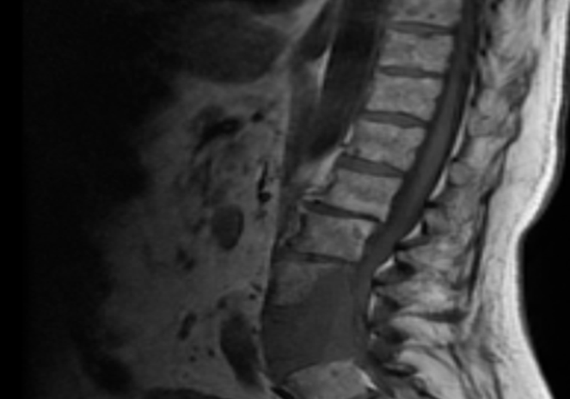
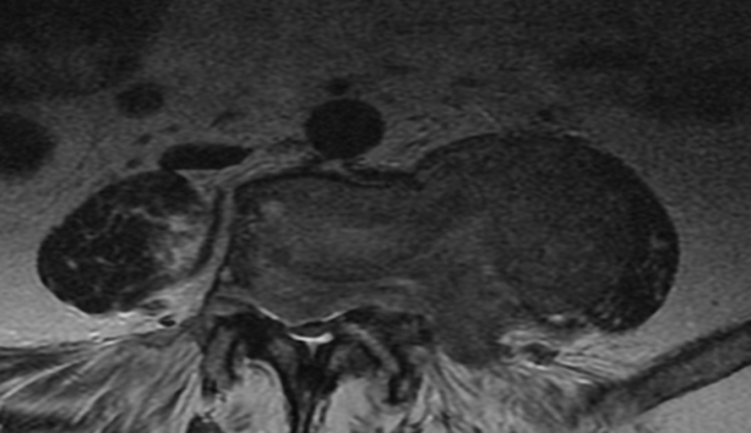
Supportive care
Assessment of Spinal stability- urgent if affected
IF Spinal cord Compression: Urgent RT is the KEY
kyphoplasty and verteboplasy in selected cases
Zolindronic acid reduces Skeletal event significantly
Usually 4mg monthly for 24 months (? 3 monthly)
Some degree of anti myeloma effect (Myeloma 9 trial)
4 years data now questioning the anti myeloma activities

Slide 22
STEM CELL TRANSPLANTATION
The Intergroupe Francophone du Myelome trial compared
Early versus delayed ASCT in patients treated with VRd followed by
lenalidomide maintenance for 1 year.
Patients were randomized to receive
Either VRd (3 cycles) followed by ASCT and then VRd consolidation
(2 cycles) versus VRd × 8 cycles with ASCT reserved for relapse.
Attal M, Lauwers‐Cances V, Hulin C, et al. N Engl J Med.
2017;376(14):1311‐1320

Slide 23
STEM CELL TRANSPLANTATION
Both arms received lenalidomide maintenance for 1 year.
A significant improvement in progression‐free survival (PFS) was seen as expected with early ASCT
This has so far not been translated into a difference in overall survival (OS).

Slide 24
Allogeneic transplantation is still investigational in Myeloma
Can be considered for young patients
with high‐risk disease in first relapse or
Exclusively patients choice after risk benefit discussion
30-40% Mortality in some centres
Preferably under clinical trials if available

Slide 25
MAINTENANCE THERAPY
Maintenance with lenalidomide is the standard of care for most
patients after initial therapy
In a meta‐analysis of randomized trials
A significant improvement in PFS and OS was seen with
lenalidomide maintenance compared with placebo or no therapy
For high‐risk patients, bortezomib‐based maintenance should be considered.
Attal M, Palumbo A, Holstein SA, et alJ Clin Oncol. 2016;34 (suppl):A8001. (abstract)

Slide 26
RELAPSED MM
Almost all patients with MM eventually relapse
The choice of a treatment regimen at relapse affected by many factors
Timing of the relapse
Response to prior therapy
Aggressiveness of the relapse and
Performance status (TRAP)

Slide 27
Patients who are eligible for transplantation
should be considered for the procedure if they have never had one before or had an excellent remission duration with the first transplantation

Slide 28
Relapsed MM
Three daratumumab‐based combinations have shown efficacy
DRd DVd DPd
Carfilzomib, Lenolidomide, dexamethasone(KRd)
Ixazomib, lenalidomide, dexamethasone (IRd);
Elotuzumab, lenalidomide, and dexamethasone (ERd);
and various
Pomalidomide‐based regimens :
Carfilzomib, pomalidomide, and dexamethasone (KPd).
For aggressive relapses, anthracycline‐containing regimens may be useful.

Slide 29
Relapsed MM
Other drugs to consider for relapse include
panobinostat, a pan deacetylase inhibitor
Bendamustine, lenalidomide, and dexamethasone; or bendamustine,bortezomib, and dexamethasone.
Venetoclax (BCL 2 inhibitor) appears to have single agent activity in patients with t(11;14) subtype of MM.

Slide 30
Relapsed MM
Two of the most exciting investigational options are chimeric antigen receptor T cells (CAR‐T)
Targeting B‐cell maturation antigen (BCMA) such as bb2121,9 and GSK2857916 (a humanized anti‐BCMA antibody that is conjugated to monomethyl auristatin‐F, a microtubule disrupting agent).
Berdeja JG, Lin Y, Raje N, et al. Durable clinical responses in heavily pretreated patients with relapsed/refractory MM: updated results from a multicenter study of bb2121 anti‐BCMA CAR T cell therapy. Blood. 2017;130:740.

Slide 31
CAR T cell Cartoon

Slide 32
Other agents with single‐agent activity that are
Promising include isatuximab, selinexor, and LGH‐447 (a pan PIM
kinase inhibitor).

Slide 33
Case 1
47 years old
Sternal bone pain: PET and Bloods: Solitary bone plasmacytoma
RT -Curative intent
Relapsed after 1 year with Serum free light chain 5,000
VTDX6 then ASCT
Exclusively asked for Sib Allo
Allo HSCT October 2018
Severe GVHD, viral infections BUT now well October 2019

Slide 34
Case2
79 years old
Anaemia and high Calcium 3.19
Evaluation confirmed MM- BM 90% Plasma cells, PP 60gm/l Free light chain 20,000
Extensive Lytic bone lesion
Melphalan, Valcade, Dex MVdX6
CR
Zometa for 2 years on-going

Slide 35
Case 3
81 years old female
AKI , Creatinine 500
Bloods , free light 2000, lambda, PP 34g/l HB 67, PLT 25, WCC Normal
Bone marrow 56% clonal plasma cells
Valcade/dex/cyclo started- No response
Dara/Valcade/Dex 2 months-No response
Ixazomib/Revlimid/Dex 2 cycles: poor response
Currently on Ponabinostat/Valcade and dex

Slide 36
Case 4
78 years old man
Skin rash and joint pain
Pp 12 g/l lambda, free light chain 300 lambda, HB 100,UES NAD
Evaluation : Confirmed Type 1 crygolobulinaemia
Needed emergency PEX and toe amputations
Started Valcade/dex/cyclo-No response
Switch to Rev/dex/ixazomib-No response
Dara/valcade/dex- Minor pp response BUT needed PEX
ASCT-after risk benefit discussion: 20 days post

Slide 37
Summery
Myeloma : Complex entity
Newer therapies are coming fast
Discovery of targeted therapies changing outcomes
Stem cell transplantations: Needs clarifications in the Era of newer options ( On-going Clinical Trials)
Emerging new techniques: CAR T Cell therapies might change the landscape how we treat the Complex diseases

Slide 38
Thank you for your attention
Question

