Slide 1
Abnormal marrow signal and mystery of Hypercalcemia
Grand round 13th April 2017
Southend University Hospital NHFT
Dr Amin Islam
Dr Tara Maisel
Dr Paul CERVI
Dr K Madhavan

Slide 2
PW – 70yr old male
Known – Diabetes, Diabetic retinopathy, Previous episodes of anterior uveitis (secondary to IBS?), under ENT for hoarse voice, Respiratory for persistent cough and orthopaedics for L5 radiculopathy
Referral to Haematology
  Abnormal MRI signal and small volume mediastinal lymph node on CT scan
    ? Myeloma ? Lymphoma
  Calcium 2.80

Slide 3
Extensive bone marrow infiltration, to exclude haematological malignancy

Slide 4
Nerve compression symptoms consistent with L4 L5
No systemic B-symptoms,
Examination un remarkable
No palpable adenopathy or organomegaly
No skin rash

Slide 5
medications
Amlodipine
Sitagliptin
Atrovastatin
Mesalazine
Lisinopril
Metformin

Slide 6
Haematology Investigations
Bloods
  Normal Kappa/Lambda ratio
  Normal Immunoglobulins
  No monoclonal paraprotein detected
  Creatinine 144, Urea 5.5 , LDH 356
  B12 , folate, Ferritin all NORMAL
  Calcium 3.18, low PTH 0.56 low, ALP 229 high
  Zolindronic acid started

Slide 7
Bone Marrow test
  Aspirate - Normal marrow with few reactive plasma cell are seen, no infiltrations
  Trephine - Trileneage haematopoiesis noted with normal maturation, no evidence of infiltration or dysplasia noted
  Serum ACE: low 9 Normal (20-82)

Slide 8
Endocrine advise – Likely metastatic disease related hypercalcaemia
Referred to Oncologists for ?CUP causing hypercalcaemia
    CT chest - early interstitial lung disease

Slide 9
What next
Bone scan : NAD

Slide 10
PET CT
  Metabolically hyperactive lymph nodes above and below the diaphragm in addition to intense uptake within the spleen. The findings raise the possibility of a lymphoproliferative disorder such as lymphoma

Slide 11
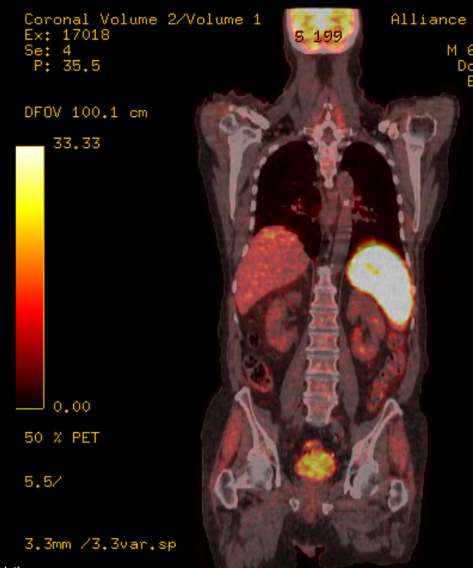

Slide 12
Respiratory review
EBUS from mediastinal Lymph node: NAD
Repeat Bone marrow trephine different site: NAD
Urinary calcium: Normal
Referred to Colchester for
Splenic biopsy to look for lymphoma

Slide 13
Bilateral Uveitis
Persistent dry cough
CT chest – early intersitital lung disease
Persistent Hypercalcaemia
Low serum ACE
Low PTH
Differentials?

Slide 14
Splenic biopsy
Non-caseating granulomatous lesions highly likely to be sarcoidosis
ZN stain negative.
TB culture : negative

Slide 15
Special blood tests

Slide 16
Prednisolone 20 mg started 27/1/2017. Calcium trend

Slide 17
ALP

Slide 18
Sarcoidosis and haematology
High calcium
Mediastinal and other regional adenopathy
Abnormal bone marrow signal
?Myeloma? Lymphoma? CUP

Slide 19
Sarcoidosis
Sarcoidosis is a multi-system granulomatous disorder
Affects people of all racial and ethnic groups
Occurs at all ages
usually develops before the age of 50 years
Incidence peaking at 20 to 39 years.
The incidence varies widely throughout the world
probably because of differences in environmental exposures
surveillance methods, and predisposing HLA alleles and other genetic factors.

Slide 20
Highest annual incidence of sarcoidosis has been observed in northern European countries (5 to 40 cases per 100,000 people)
first reported association between sarcoidosis and specific gene products was the association between class I HLA-B8 antigens and acute sarcoidosis.
Subsequently, HLA class II antigens, encoded by HLA-DRB1 and DQB1 alleles, have been consistently associated with sarcoidosis.

Slide 21
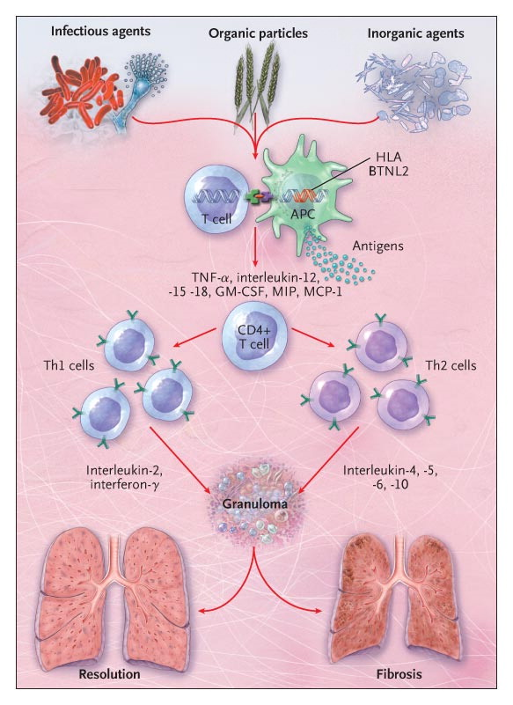

Slide 22


Slide 23
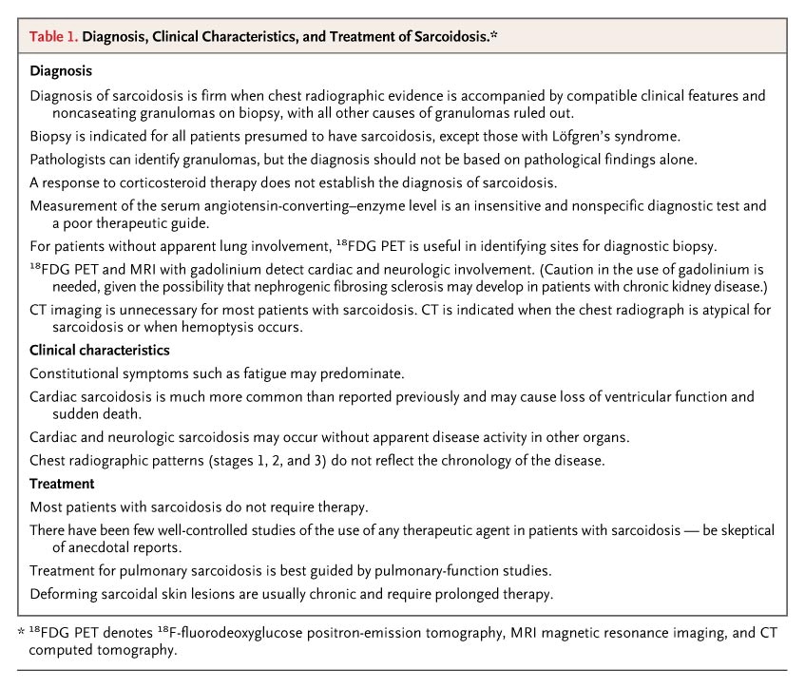

Slide 24
Serum ACE in sarcoidosis
Sarcoidal granulomas produce angiotensin-converting enzyme (ACE)
ACE levels are elevated in 60% of patients with sarcoidosis.
However, the value of serum ACE levels in diagnosing or managing sarcoidosis remains controversial.
Although ACE levels are influenced by ACE gene polymorphisms
measurement of serum ACE levels lacks sensitivity and specificity.

Slide 25
Hypercalcemia and Sarcoidosis
Dysregulated calcium metabolism is well‐recognized
Resulting in hypercalcaemia
prevalence 5–10%
Hypercalcuria (40–62%)
Reduced bone density (40–55%).
Extrarenal synthesis of calcitriol [1,25(OH)₂D₃]
is central to the pathogenesis of abnormal calcium homeostasis
Alterations in parathyroid hormone (PTH) activity and the expression of PTH‐related peptide have also been demonstrated..

Slide 26
Once formed, calcitriol regulates calcium homeostasis
by increasing the gastrointestinal absorption of calcium and phosphate
in addition to stimulating osteoclast‐mediated bone resorption and new bone formation by osteoblast
Hence the raised ALP

Slide 27
Normal calcitriol production
Previtamin D₃ then isomerizes spontaneously to cholecalciferol, which undergoes 25‐hydroxylation in the liver followed by 1‐α hydroxylation in the kidney to form calcitriol [1,25(OH)₂D₃], the metabolically active form of vitamin D₃
Absent feedback mechanisms cause the dysregulation of calcitriol production by macrophages in sarcoidosis

Slide 28
The immunosuppressive properties of calcitriol suggest that the raised levels seen in sarcoidosis could represent an adaptive response to the undefined antigen that causes sarcoidosis

Slide 29
Long‐standing hypercalcaemia and hypercalcuria
Can cause nephrocalcinosis
Accounts for over half the patients with sarcoidosis who have renal impairment
Nephrolithiasis in approximately 10% of patients

Slide 30
More rarely tubular disorders such as nephrogenic diabetes insipidus
Symptomatic hypercalcaemia presenting with dehydration, polyuria and an altered conscious state is a rare but recognized complication of sarcoidosis

Slide 31
Parathyroid hormone in sarcoidosis.
PTH release is inhibited by hypercalcaemia and high levels of calcitriol
which explains why the PTH level is suppressed in sarcoidosis

Slide 32
Parathyroid hormone‐related peptide
In 1987 a novel protein was identified in a number of patients with hypercalcaemia of malignancy
This protein had properties similar to PTH and was termed parathyroid hormone‐related peptide (PTHrP).
Precursor PTHrP is transcribed from a gene located on the short arm of chromosome 12

Slide 33
Liver and Spleen Involvement
over 10% of all patients with sarcoidosis have elevated serum aminotransferase and alkaline phosphatase levels.
liver involvement is usually clinically silent.
Detection of hepatic and splenic lesions on computed tomography is described in 5% and 15% of patients, respectively

Slide 34
Nearly 60% of patients with hepatic manifestations of sarcoidosis have constitutional symptoms such as fever, night sweats, anorexia, and weight loss.
Liver involvement is at least twice as common in black Americans as in white Americans.

Slide 35
Bone and Joint Involvement
With new imaging techniques (MRI and PET), bony lesions scattered throughout the skeleton are often detected in patients with sarcoidosis
May be confused with metastatic bone lesions. Although skeletal lesions may cause pain, most are asymptomatic. Chronic arthralgias are more common than frank arthritis.

Slide 36
In addition to its role in hypercalcaemia of malignancy
PTHrP is involved in the differentiation of human cells and in calcium metabolism in sarcoidosis.
The recent observation of high PTHrP levels in two patients with hypercalcaemia and sarcoidosis prompted Zeimer et al. to look for evidence of PTHrP gene expression in sarcoid granulomas.

Slide 37
Corticosteroids are of value in all forms of hypercalcaemia as they reduce gastrointestinal calcium absorption
Inhibit osteoclast function but are particularly effective in sarcoidosis because of their effects on vitamin D metabolism.
Although corticosteroids have no effect on 1α‐hydroxylase in the renal tubular cell, they are potent inhibitors of this enzyme in the macrophage

Slide 38
Corticosteroids also bind to cytokine promoter regions in the macrophage nucleus, down‐regulating IL‐2 and IFNγ expression and resulting in reduced PTHrP production by macrophages.

