Slide 1
Clinicopathological Case Conference of Haematological Medicine
Case of the week
21st April 2017
Video linked
Southend , Basildon and Chelmsford University Hospitals NHS foundation Trust (ESR). East of England, United Kingdom.
Dr Amin Islam MB, MRCP UK, FRCPath UK
Consultant Haematologist

Slide 2
66 years old gentleman
Presented with
Being unwell
Occasional bruising for 3 days
Emergency department assessment
GCS 15/15
Temp 37.6 c
BP 145/60
Saturation on ambient air 90%
RR 16 /m, BM 6.0,
Respiratory/cvs/neuro/abdominal: NAD
Bloods sent

Slide 4
What useful test would do next?

Slide 5
Blood film

Slide 6
What is the diagnosis?

Slide 7
Differentials
TTP
MAHA secondary to
HUS?
Drugs?
Metastatic malignancy?
Severe infections?

Slide 8
Past medical history
Pancreatic tail adenocarcinoma
On gemcitabine as palliative chemo for 2 months
Nil else

Slide 9
What is the diagnosis
Drugs induced MAHA

Slide 10
How do you manage this patient

Slide 11
To exclude TTP
Send
ADAMATS13 as urgent
Results came back as normal activity
78% normal
Idiopathic TTP : PEX
If neurology and cardiac: Upfront Rituxmab
Role of steroid : unknown but on the protocols

Slide 12
Repeat film

Slide 13
Conservative management
Stop drugs for good
Palliative care
Clinical trial options?

Slide 14
drugs can cause MAHA/TTP
The clinical features of TTP-HUS associated with these drugs are different, suggesting two principal mechanisms by which drugs may cause TTP-HUS:
Dose-related toxicity (mitomycin C, Gemcitabine, cyclosporine),
immune-mediated reaction (quinine, ticlopidine, clopidogrel).
The role of plasma exchange is uncertain,
but this treatment is appropriate because of the high mortality and morbidity of drug-associated TTP-HUS.

Slide 15
Thrombotic thrombocytopenic purpura
Medical/haematological emergency
Diagnosis is clinical and THE BLOOD FILM
Untreated mortality >90%
Incidence UK 2.2 /million
USA 4/million
TTP is almost always acquired.
Patients with congenital TTP (Upshaw-Schulman syndrome) caused by a mutation of the ADAMTS13 gene¹⁸ are rare;

Slide 16
Association or/secondary causes <30%
Infection /HIV
Pregnancy
Malignancy
Autoimmune conditions

Slide 17
Classic pentad (fever, thrombocytopenia, microangiopathic hemolytic anemia (MAHA), elevated creatinine, and neurologic symptoms) only seen in 1/3 of patients.
Discovered 44 yrs ago before the introducicon of plasma exchange era

Slide 18
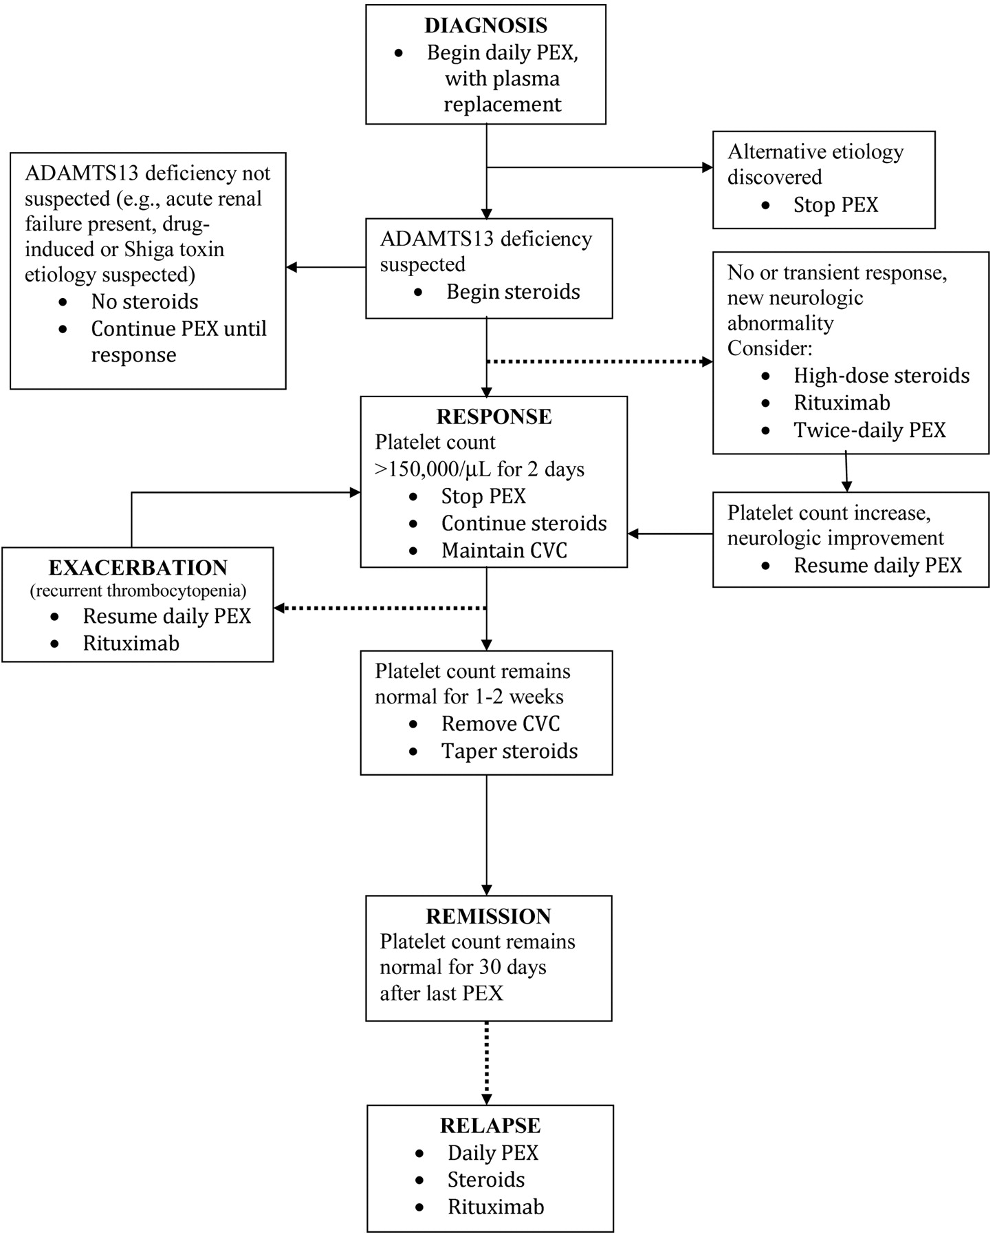

Slide 19
TTP secondary
IgG autoantibody against ADAMTs13
Role of rituximab
Role of steroids
Rarely Autograft done

Slide 20
Learning points
Recognition of a drug-associated aetiology in a patient with TTP-HUS is critical to avoid re-exposure and recurrent illness.
Initiate PEX if clinically suspected
D/W referral centre and either transfer or DO urgent ADAMTS13

