Slide 1
Interpretations of Abnormal Haematology Results
Post graduate Foundation doctors teaching
14th march 2017
Lecture theatre
Education centre
Dr Amin Islam MBBS, MRCP UK , FRCPath UK
Consultant Haematologist

Slide 2
Patient 1 92 years old lady, leg swelling in ED

Slide 3
What would you do next

Slide 4
History
Onset
Progress
Duration
PMH
Drugs history
FH
Recent bleeding or hospital admission

Slide 5
Next steps
US legs looking for bleeding or clots
Specialised blood tests
Haematology advise

Slide 7
What are the differential

Slide 8
Not correcting with 50/50 mixing study
Inhibitors
Immediate acting ; lupus
Delayed acting : acquired factor deficiency due to inhibitors

Slide 9
Management complex
Haematology referral urgent if acquired haemophilia
If LUPUS then : reassure or assess if risk factors for clots
Surgery is not at risk of bleeding
Records on noted

Slide 10
Patient 2 71 years old man
PR bleeding
On Ribaroxaban for AF
PT 15 , APTT 120, Fibronogen 7.0 , D dimer normal
HB 100 WCC 5.6 PLT 560

Slide 11
What would you do next?
Could it be due to Ribaroxaban (anti Xa)?

Slide 12
History
Onset
Progress
Duration
PMH
Drugs history
FH
Recent bleeding or hospital admission

Slide 13
Repeat the test
Specialised blood test
50/50 mixing study
Not correcting
Inhibitor study
Lupus negative
Factor 8 Inhibitor done :170 BU/ml
Treated at RLH
Steroid and cyclophosphamide

Slide 15
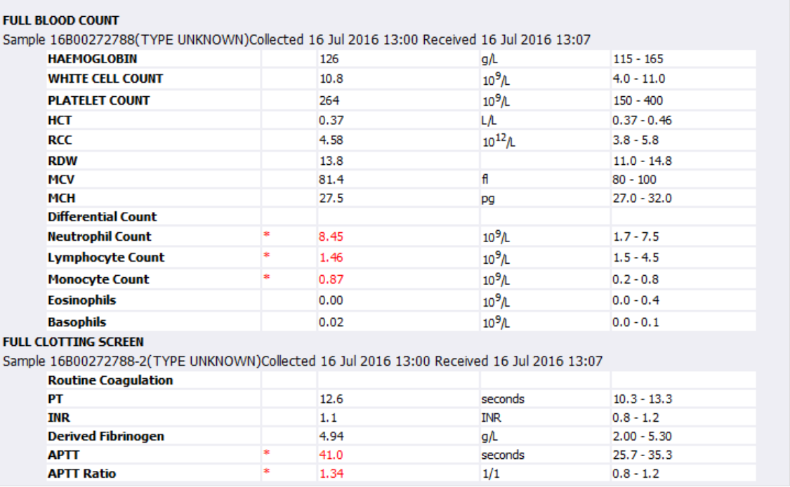
Another example to remember

Slide 17
Typical lupus study at laboratory

Slide 18
Few take home points
Acquired haemophilia is very rare
Serious and life threatening
If not treated is fatal
Often mistaken as DVT
Must do clotting test before anticoagulation as baselines
If clotting screen abnormal then consultant
Prolong APTT with lupus: DO NOT BLEED
Acquired haemophilia needs complex care in tertiary centre

Slide 19
Patient 3 67 years old lady in OPD

Slide 20
What would you do next?

Slide 21
Detailed history
PMH
Drugs
B symptoms
Clinical examination
Any organomegally or adenopathy

Slide 22
Further tests
Blood film urgent by consultant
Haematology referral urgent
Admit
Full clotting screen
Full biochemistry
DAT
Retciculocytes
virology

Slide 23
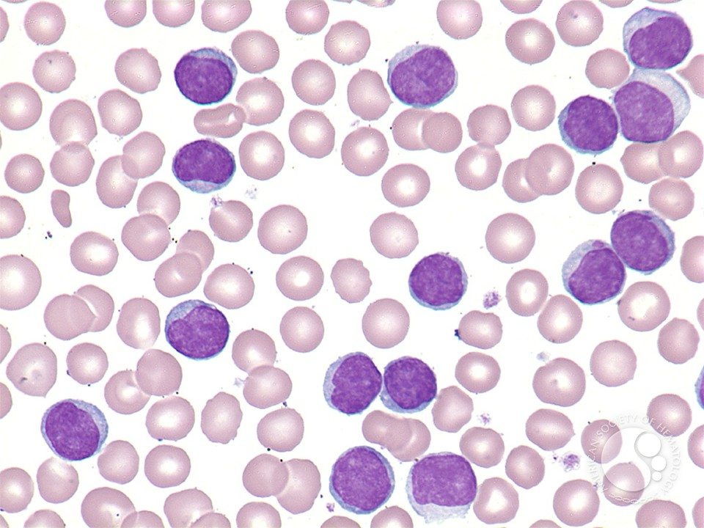

Slide 24
Specialised test
Flow cytometry
SPE
CT CNAP

Slide 25
Diagnosis
T PLL
Treatment
CAMPATH and A allogeneic Stem cell Transplant if fit
Or Pentostain as palliative
Poor response
High mortality
Risk of viral reactivations is very high

Slide 27
Another example

Slide 28
This patient has
CLL on flow cytometry
Staging scans
Virology
Bone marrow test
MDT FCR chemo
CR after 6 cycles
well

Slide 29
Take home points
Get expert help early
Needs a blood film urgently reviewed by haematologist
What you see on total counts can be misleading
Priority is to exclude acute leukaemia
Rare disease come as a surprise not infrequently

Slide 30
Patient 4 77 years old lady in Emergency rhesus

Slide 31
What would you do next?

Slide 32
Ask for help ASAP
Full clotting to exclude DIC
Blood film to confirm
Haematologist to review in rhesus
Resuscitate

Slide 33
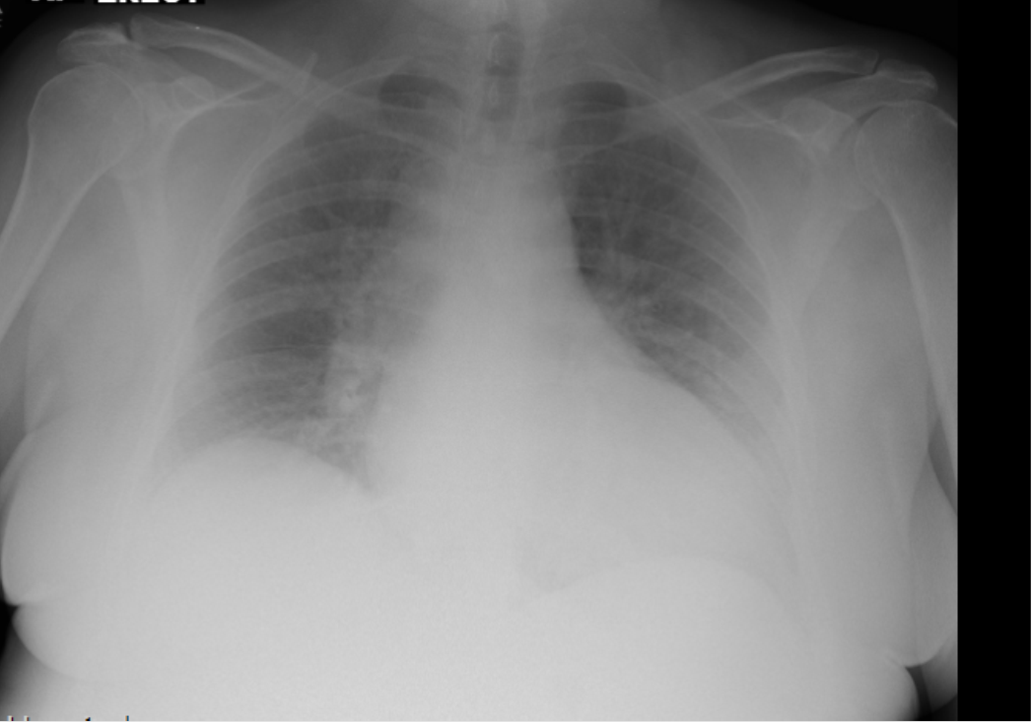
leucostasis

Slide 34
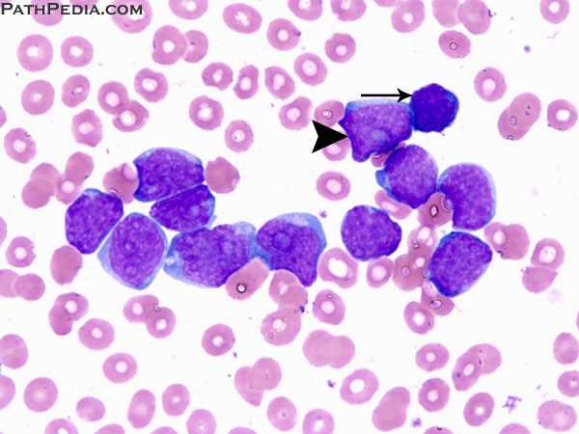
Blood film

Slide 35
Emergency leucopheresis
And emergency cytoreductive in ICU
Typically use
IV CYTARABINE
Or alternative emergency exchange transfusion can be done

Slide 36
Bone marrow

Slide 37
Further test
Biochemistry
Repeat clotting
Bone marrow test
Virology
Molecular study and cytogenetics

Slide 38
Treatment
AML protocol
Specialised care
Intensive chemotherapy
Risk of tumour lysis syndrome
Daily twice bloods
Electrolytes managements crucial

Slide 39
Take home points
Acute leukaemia is medical emergency
Early intervention by haematologist is crucial
Emergency leucopheresis is life saving in leucostasis case
Emergency cyto- reduction is essential
Careful monitoring of chemistry, FBC, clotting
Correct any abnormalities ASAP

Slide 40
Patient 5 92 years old gentleman

Slide 41
What would you do next

Slide 42
Further tests

Slide 44
Specialised test
Bone marrow if appropriate
Skeletal survey
CT/MRI spine
Serum free light chain

Slide 45
Diagnosis
Multiple myeloma
Treatment varies according to age and or suitability of stem cell transplantation
Typically
VTD/MPV/CTD
Multiple lines of treatment available on relapses
Clinical trial options available

Slide 46
Few take home points
Risk of infection is high in myeloma
Early introduction of renal friendly antibiotics essential if infections suspected
In renal failure early dexamethasone and renal dialysis can be reversible
Time is of essence
Managed in multidisciplinary approach
Bone protective has prognostic values

Slide 47
Patient 6 What do you think about this 89 years bloods?

Slide 48
What next?

Slide 49
Film
Haematinics
Chemistry
Virology
Bone marrow if fit otherwise film is diagnositc

Slide 50
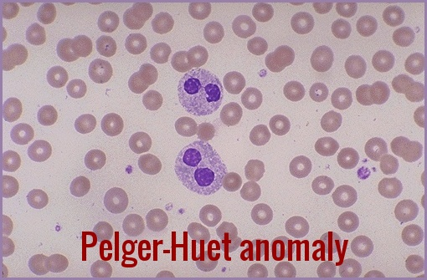
Blood film diagnosis of MDS

Slide 51
Diagnosis
Myelodysplastic syndrome
Management according to stage
PS and patient choices

Slide 52
Take home points
Very common after age 70s 80s
Management is complex
Risk of infections and
Demand of transfusion
Multi transfuse patient has multiple antibodies due to repeated transfusion
Refectory case should have HLA/HPA antibodies checked to transfuse right match

Slide 53
Patients 7 in stroke ward

Slide 54
Differentials

Slide 55
CT CNAP

Slide 56
virology

Slide 57
Biopsy from inguinal node

Slide 58
Caribbean patient
What other virology essential??

Slide 60
CXR worse

Slide 61
Patient on
Tazocine
Valganciclovir for CMV
Clarithromycine
Too frail for definitve CHOP

Slide 62
What else would you star?

Slide 63
High dose spetrin 120mg/kg in 3 divided doses 2-3 weeks
BAL to confirm when stable
PCP detected on BAL from GOSCH

Slide 64
Patient 8 known low grade follocular lymphoma

Slide 65
What happened ?

Slide 66
hydronephrosis
Due to retroperitoneal mass
?high grade transformation

Slide 67
treatment
Emergency stent/nephrostomy
Steroid high dose
Definitive treatment
Urgent biopsy to confirm the grade/? Transformed
R Chemo ASAP

Slide 68
Take home points
Abdominal mass has potential of organic obstructions
Careful monitoring essential
Act urgently
Confirm diagnosis early and start treatment
Early referral to specialist essential while waiting evaluation

Slide 69
After stent blood at 22 hours

Slide 70
Thank you for your attention
Questions??

