Slide 1
Common Tests and What Next
Haematology for GP practices
Sharing Common haematology indices and
interpretations
Haematology for GP practices
Contact:
Private secretary: 07788 374104
diane.burgess@southend.nhs.uk

Slide 2
Dr Amin Islam MB, MRCP UK, FRCPath UK
Consultant Haematologist
Southend , Basildon and Chelmsford University hospitals NHS foundation Trust (ESR). NHS England, United Kingdom.
Private work
Spire Wellesley Hospital , Southend –On-Sea
Every Friday from 1700 HRS
Website :www.janaanhealth.org

Slide 3
GP update
The Saxon Hall
Southend –ON-Sea
4th February 2017

Slide 4
Patient Based Discussion 1
66 years old gentleman
Day 10 post abdominal surgery due to bowel mass
High temperature and cough with green phlegm
Occasional haemoptysis
Known COPD and type 2 DM
O/E septic patients with oozing from the wounds

Slide 5
What is the differentials
Wound infection
Septicaemia and DIC
Pneumonia
PE
Exacerbations of COPD

Slide 6
Further test AE sent
HB 85, WCC 20, neutrophils 16, lymph 2.2
PLT 20
CRP 290, Urea 12, creatinine 100,
LFTs : normal
Full clotting screen: PT 50 APTT 100, Fibrinogen 0.5, TT 45
Blood culture sent
CXR NAD only COPD changes , nil new.

Slide 7
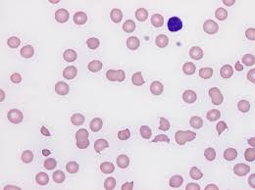
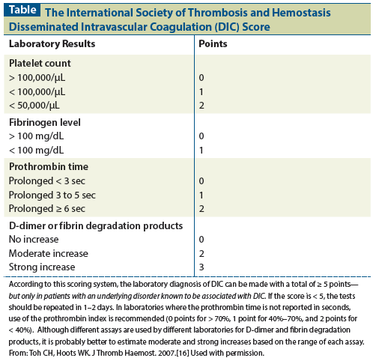
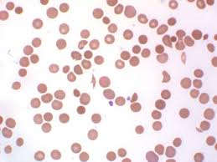

Slide 8
DIC
DIC is always secondary
Treatment of underlying cause
In this case is wound sepsis is likely
Broad spectrum antibiotics essential get micro advise
Correct the clotting
CRYOPRECIPITATE 30MINUTES THAWING TIME
Give PLT only in moderate to severe bleeding
Monitor clotting frequently and give cry/FFP as necessary

Slide 9
DIC
Microthombosis
MAHA
Risk of thrombosis
Some authorities still give iv heparin carefully
Treatment of the cause can reveres the process only
Thrmboprophylaxis early once the bleeding stopped

Slide 10
Common causes
Severe sepsis
Major trauma
Cancer
Amniotic fluid/fat embolism
Snake bite
Hypothermia
Major surgery and massive transfusions

Slide 11
Patient Based Discussion 2
78 yrs old gentleman
Routine blood test
HB 100
MCV 95
WCC 6.5 , Neut 4.3
PLT 168
Urea 4.0 Creat 76
LFT normal
Globulin 40 (Normal 20-35 g/L)
Calcium 2.36

Slide 12
Next steps
Immunoglobulin's
Paraproteins
Bone profiles
Serum free light chains
B2 microglobulins
SKS?
BM? After reviewing by haematologist
Serum erythropoietin

Slide 13
More test
PP 10g/L
SFLC ration normal
B2mg 2.0 normal
Serum EPO 10 normal
SKS: NAD
Bone marrow not always necessary
BMAT 5 % plasma cells (done due to anaemia)

Slide 14
Common advice to patient
Watch for unusual pain and aches
Back pain
Recurrent infection
Report early when waiting to be seen

Slide 15
MDT
Diagnosis
MGUS low risk and anaemia of chronic disease
Advise/patients education
Routine follow up 3 monthly and if stable then
Discharge with GP follow up

Slide 16
Monitoring of MGUS
-
Advice applies to very low risk patients with MGUS: IgG band, less than 15 g/L and normal Free Light Chains)
Monitor FBC, U&E, Creatinine and Ca++ and Serum Electropheresis annually
Dipstick urine for protein annually
Reasons to re-refer:
  • Monoclonal Band rising unexpectedly (>50% increase compared to baseline)
  • Developing a significant cytopenia (for instance):
  Hb dropping below 10 g/dl; Neutrophils below 1.5 x 10⁹/l; Platelets < 80 10⁹/l
  •Developing renal impairment; Severe proteinuria with 24 hrs proteins >1,5g/24 hours or ++ or +++ on Dip stick examination.
  • Unexplained hypercalcaemia
  • Pathological fracture • Unexplained bone pain #• L nodes enlargement with >3 lymph nodes >3 cm diameter
  • Unexplained weight loss > 3 kg within <3 months of time.

Slide 17
Referral of patients with MGUS
Disorders characterised by the production of a paraprotein include monoclonal gammopathy of undetermined significance (MGUS), multiple myeloma and Waldenströms macroglobulinaemia. Paraproteins may also be a feature of CLL, NHL or amyloidosis. MGUS is a diagnosis of exclusion: 3% of over the age of 70 and 5% of over the age of 80 have a paraprotein which is frequently found incidentally and not associated with symptoms or physical findings. The overall risk of MGUS progression to myeloma is around 1% per year – this remains constant over time.
Referrals to Haematology should not be made for patients with raised immunoglobulin levels in the absence of a paraprotein band on serum electrophoresis. Polyclonal gammopathy implies a non-specific immune reaction and is not associated with underlying haematological disorders.
The following should be referred urgently for outpatient assessment:
• Any new paraprotein with accompanying features suggestive of multiple myeloma or other haematological malignancy:
• hypercalcaemia; • unexplained renal impairment; • urinary Bence Jones proteins
• bone pain or pathological fracture
• radiological lesions reported as suggestive of myeloma
• anaemia or other cytopenia
• hyperviscosity symptoms (headache, visual loss, acute thrombosis)

Slide 18
Patient Based Discussion 3
17 years old
Feverish for 3 days
Cough
OE: low grade pyrexia. NIL else
HB 14
WCC 21.1 Neut 0.8, lymphocytes 20
PLT 120
CRP 10
UES/ normal ALT 100 raised
Blood film comments
Atypical lymphocytes noted, neutropenia confirmed, mild thrombocytopenia noted, no blast seen, please repeat in 1 weeks time. ?any recent viral illness

Slide 19
Be aware of
Persistent neutropenia
Anaemic
Bone pains
Might need serial blood test and specialist review to exclude ALL?/

Slide 20
Neutropaenia
Neutropenia is defined as a neutrophil count of less than 1.7 x 10⁹/l. Please note, that the normal range for Africans/Afrocaribbeans is 1.0-7.0 x 10⁹/l. Risk of infective complications is closely related to the depth of the neutropenia: a major increase in infections is seen with counts of <0.5 x 10⁹/l while some increased risk of infection is seen with counts of 0.5-1 x 10⁹/l.
Causes of neutropenia include viral infection, sepsis, drugs, autoimmune disorders and bone marrow failure due to aplasia, malignant infiltration or B12 / folate deficiency.
The following should be referred urgently for outpatient assessment:
Neutrophil count < 1 x 10⁹/l;
Neutropenia in association with: other cytopenia (Hb < 10g/dl, Platelets < 50 x 10⁹/l)
lymphadenopathy;
splenomegaly

Slide 21
Patient Based Discussion 4
73 yrs old
Type 2 DM
HTN
HB 100, MCV 90 , wcc 5.9 PLT 150
Creatinine 140, urea 10.0
LFTs normal
Bones profiles normal

Slide 22
Next line of test
Blood film, normochromic anaemia with mild age related dysplasia noted, anisopoikilocytosis
B12-normal , folate- normal, ferritn- normal
Protein EP normal pattern

Slide 23
Diagnosis
Anaemia of chronic disease (ACD)
Management
Watch and wait
If symptomatic TRIAL OF EPO ?
Usually EPREX for patient HB<95
Epoietin works best when serum ferritin is 200-400

Slide 24
Patient Based Discussion 5
30 Years old
Caribbean lady
Routine blood test after complaining of tiredness
HB 110, WCC 6.8 PLT 340, MCV 60
UES LFTs Bones profiles NAD
Blood film : microcytic hypochromic. Nil else
Advised by lab please check haematinics/ferritin if normal then consider checking haemoglobinopathies HB EP

Slide 25
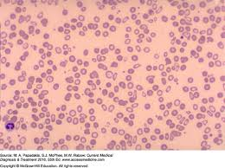
Next tests
HBE normal pattern
Normal A2 , A and hbf 1%
Please consider alfa thalassemia advised from lab

Slide 26
Alfa beta thalassemia carriers
Southeast Asia: thalassemia trait in 1-30% of the population, up to 40% genetic carriers
Sub-Saharan Africa: thalassemia trait in 0% of the population, up to 50% genetic carriers
Western Pacific: thalassemia trait in 0% of the population, up to 60% genetic carriers
Eastern Mediterranean: thalassemia trait in 0-2% of the population, up to 60% genetic carriers
America: thalassemia trait in 0-5% of the population, up to 40% genetic carriers
Europe: thalassemia trait in 1-2% of the population, up to 12% genetic carriers

Slide 27
Patient Based Discussion 6
80 years old man
H/O some non specific weight loss
Recurrent infection
HB 10, WCC 60 Neutrophils 4.0 Lymph 50, PLT 45
Blood film
Smear cells and plentiful of mature lymphocytes with occasional pro lymphocytes
Suggestive of CLL/LPD
Urgent haematology referral advise

Slide 28
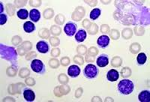
CLL blood film

Slide 29
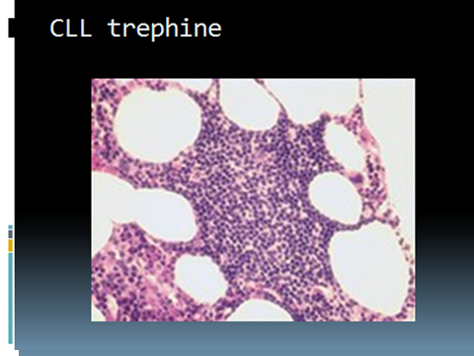

Slide 30
Referred to haematology
Blood test repeat in 2 weeks
HB 100, WCC 120 Neut 1.0 lymphocytes 110, film consistent with CLL/LPD
Flow cytometry CLL 5/5 Marsden score
BMAT 80 % infiltration
Low immunoglobulins
Cytogenetic 11q ,17P deletion
Patient started on Ibrutinb (BTKI)

Slide 31
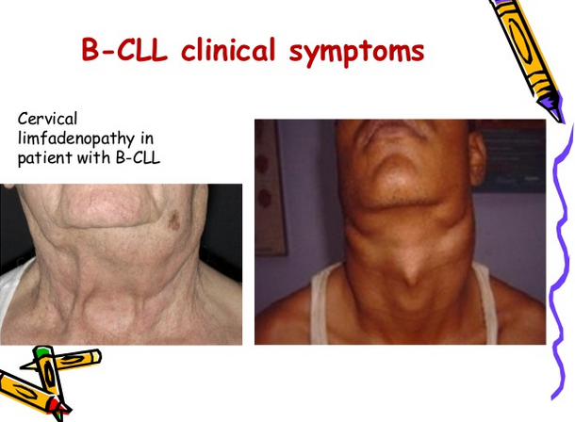
Chronic Lymphocytic Leukaemia
-

Slide 32
Patients Based Discussion 7
67 Years old
Routine blood test for diabetic check up
HB 150 WCC 23, neut 6, Lymphocytes 18, PLT 345
Blood film? Smear cells and atypical lymphocytes with clefted neucleoli
? LPD/CLL
Biochem : Normal
Advised , consider haematology referral if appropriate

Slide 33
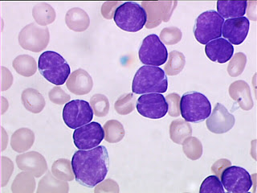
Follicular lymphoma cells

Slide 34
Haem review 2 weeks
Flow confirmed
Follicular NHL
CT left paratracheal lymphnode
Bone marrow :NAD
Bloods normal LDH :Normal
Stage 1 A F NHL
Treated with RT

Slide 35
CLL and Low Grade Lymphoma –discharge advise
Monitor FBC annually
Reasons to re-refer:
• Lymphocyte count rising rapidly (typically doubling within 6 months)
• Lymphocyte cont rising above 100 10⁹/l
• Developing a significant cytopenia (for instance):
Hb dropping below 10 g/dl; Neutrophils <1.5 x 10⁹/l; Platelets < 80 x10⁹/l
• Developing significant ‘B’ symptoms
Weight loss unexplained (Greater than 3kg in 3 months)
Drenching night sweats
PUO (documented)
Recurrent infections
• Clinical Examination:
Lymph nodes alone or in groups (>5 cm diam)
Developing ”bulky'' disease:
Bone lesions
Renal impairment; Pleural effusion if new; Hepatomegaly/Jaundice

Slide 36
Patient Based Discussion 8
5 YRS OLD CHILD
FLUE LIKE ILLNESS
Petechial rash in legs /arms
HB 150, WCC 6.0, Neut 1.0, lymp 5, PLT 10
Blood film atypical and reactive lymphocytes, thrmobocytopenia confirmed, no blast seen, /any recent viral illness, possible ITP?

Slide 37
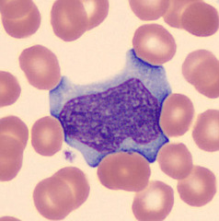
Reactive lymphocytes

Slide 38
Reviewed in paediatric inpatient
Only minor petechial
Blood test otherwise normal
Discharged home with
f/u
Twice weekly blood test
Spontaneous recovery likely
Advise……..

Slide 39
Case 8 continued
Haem consultant blood film
We look carefully for
Blast
Atypical features
Any other cytopenias
Repeat blood films important

Slide 40
Patient Based Discussion 9
51 Years old
Generally unwell for 4 weeks
HB 70 WCC 0.9 Neut 0.2, lymp 5, mono 1
UES: Normal
Bone profiles: Normal
Film comment from haematology
Pancytopenia , no blast or dysplasia noted
Urgent haematology referral advised
DW haematology consultant

Slide 41
Bone marrow trepine

Slide 42
Haem review urgent next day
Film : pancytopenia, No blast or dysplasia
Biochemistry: Normal
Haematinics: Normal
BMA: haemodiluted sample
Flow no clonal population seen
BMT : Diffuse and nodular infiltration with large cell
Immunostianing confirmed B NHL
ANA :Negative.
Virology: Negative

Slide 43
Next test
PET negative
Only mild splenomegaly
RCHOP with IT MTX
CR after 6 RCHOP
4 IT MTX
In CR

Slide 44
Patient Based Discussion 10
32 Years old
Non specific viral illness for 1 week
HB 100, WCC 5 Neut 0.4, Lymp 4 PLT 430
Film occasional cells looks blast with aures rods
Bone marrow and FISH: PML-RARA confirmed
APML
Treated with AML 17 trial ATRA+ATO
CR and cure rate >95%

Slide 45
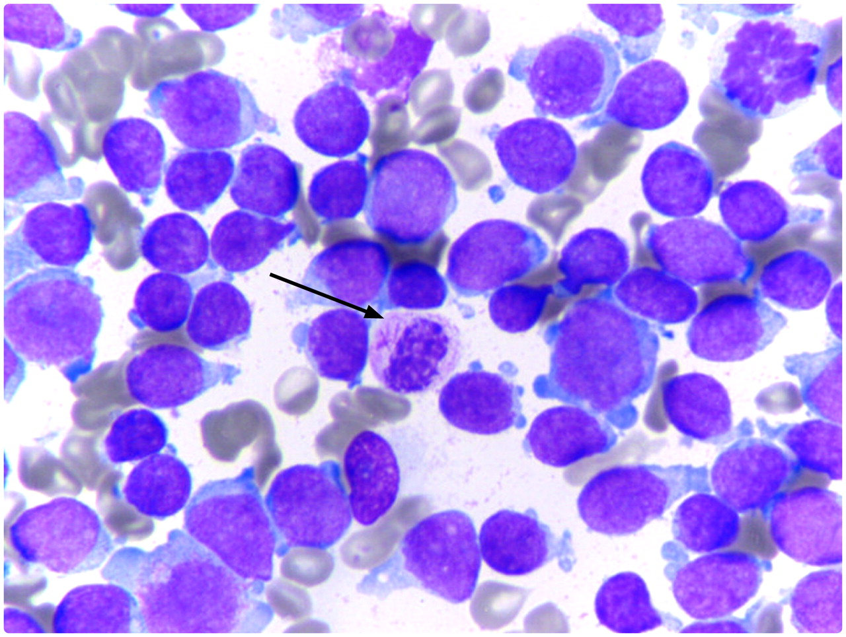

Slide 46
Patient Based Discussion 11
89 Years old gentleman
Previously well and fit
Nose bleeding
Blood test
HB 70, WCC 100, neutrophils 0.5, PLT 10
Film AML
Reviewed in AE
Best supportive care agreed
Hydroxycarbamide as cytoreductive
Palliative care referral
Died 2 months from the diagnosis

Slide 47
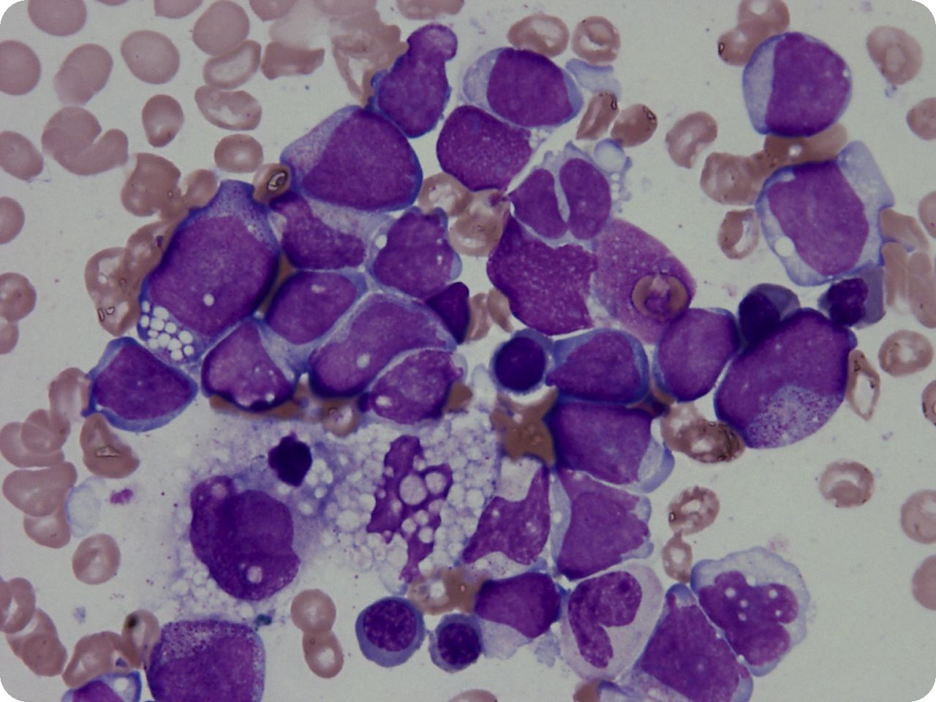

Slide 48
Elderly AML
We can offer less intensive chemo in SHU NHFT
MAC ( mitoxantrone and cytarabine)
We are building the case for
Intensive DA/ADE and Trial chemo
BCSH level 2B service in SUHNH FT
Best supportive care : no long term survivor
MAC /DA chemo for elderly: 10-16% 5 years OS

Slide 49
Patient Based discussion 12
78 Years old gentleman
Routine blood test
HB 89, WCC 12, neutrophils, 1.0 monocytes 4.0 PLT 78
Film. Monocytosis with dysplastic neutrophils, no blast noted, anisopoikilocytosis, MDS/MPN?
Refer to haematology if appropriate
Haem review
Haematinics :Normal
Biochemistry: Normal
SPE normal, haematinics: Normal
Bone marrow: MDS/MPN blast counts 3% RAEB 1
Watch and wait
Trial of EPO, GCSF if recurrent infections

Slide 50
Patients based Discussion 13
34 Years old Indian lady
Tired all the time
HB 50, MCV 60, MCH 28, WCC 6, neut 4.0, PLT 670,
Biochemistry: Normal
Blood film, micycytic hypochromic and pencil cells, consistent with IDA, look for bleeding and treat with iron

Slide 51
Continued
Detailed history
Not vegan
Intermittent diarrhoea and weight loss
Ferritin 10, B12 140, folate 6
TTG positive,
Coeliac disease
Referred to gastro
IV iron advised
Some patient with low ferritin with normal FBC benefit from iron therapy in terms of concentration, energy level and well being: anecdotal

Slide 52
Patient Based Discussion 14
17 Years old
Bone pain
HB 170, WCC 12 , neutr 4.0 lymp 6, plt 156
Biochem: Normal
Seen in AE discharge
Seen by GP analgesia
Reviewed by orthopaedics in private sector 6 weeks after

Slide 53
Continued
Repeat blood test
HB 10 WCC 12. neut 3 lymp 10 PLT 120
Ortho cons requested blood film urgent and discussed with haem
Film: film suspicious of lymphoid blast
Flow locally suggestive of ALL
Urgent tertiary referral
ALL treated with UK ALL protocol
In CR

Slide 54
Patient Based Discussion 15
33 Years old lady
Vaginal thrush and left hypochodriac pain 2 months
Blood test HB 120 WCC 24 neut 18 lymp 3, basiphils 1% PLT 600
Haem referral made
Seen in clinic by haem SPR
BCR/abl and JAK2 sent
CML Ph positive

Slide 55
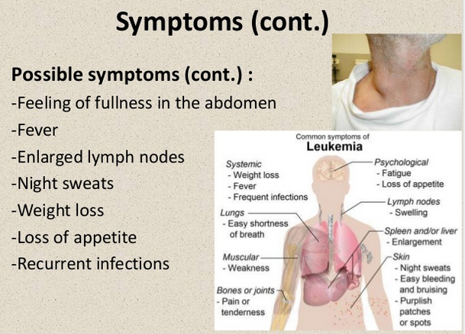
Chronic Myeloid Leukaemia

Slide 56
Reviewed in clinic 2 weeks
Repeat blood HB10 WCC 240 , PLT 700
Bcr/abl ph positive
CML
BMAT/ flow
Molecular
CML in CP
Imatinib
In CHR imatinib ongoing

Slide 57
Patient Based Discussion 16
30 Years old pregnant
20 weeks
Blood test
HB 150, WCC 8, PLT 110
Film low plt and occasioanl giant plt, no clumps , no blast or fragments noted
Gestational thrombocytopenia ? ITP
Monitor counts advised
If PLT <80 then discuss with haem

Slide 58
Patient Based Discussion 17
32 Years old
Easy bruising, epistaxis
HB 160 WCC 7 neut 4 Lymp 5, PLT 450
Biochemistry : Normal
Full clotting normal
Next line of investigations??
Haem ref?? To exclude rare bleeding disorders
VWD?

Slide 59
Patient Based discussion 18
43 Years old lady
Routine blood test
HB 170, WCC 6, neut 4 PLT 160
INR 1.0 APTT 60, Fibrinogen 5.o
UES :Normal
Bone profile: Normal
TFT :Normal
Next line of test ??
History of DVT/PE??

Slide 60
Haem review
No h/o VTE or pregnancy loss
Lupus Anitcoagulant positive
Cardiolipin antibody positive IgG strong
Treatment??
Watch
Thromboprophylaxis??

Slide 61
Thrombocytosis
Thrombocytosis/thrombocythaemia / is defined as a platelet count > 450 x 10⁹/l. It may be due to a primary myeloproliferative disorder (essential thrombocythaemia) or ‘reactive’: secondaryto infection, inflammation, chronic bleeding or neoplasia. Very high platelet counts in the setting of myeloproliferative disorders carry risk of both thrombosis and abnormal bleeding (due to platelet dysfunction).
The following should be referred urgently for outpatient assessment:
• Platelet count > 1000 x 10⁹/l
• Platelet count 600 – 1000 x 10⁹/l in association with:
recent arterial or venous thromboembolism
neurological symptoms
abnormal bleeding

Slide 62
Polycythaemia
Elevated haemoglobin has a wide differential diagnosis including primary proliferative polycythaemia (polycythaemia vera), secondary causes (such as hypoxic lung disease and erythropoietin-secreting tumours) and relative polycythaemia resulting from plasma depletion. The threshold for therapeutic intervention with venesection or cytoreductive therapy in an individual patient depends on the cause, associated symptoms and thrombotic risk factors.
The following should be referred urgently for outpatient assessment:
• Hb > 20g/dl (PCV >0.60) in the absence of chronic hypoxia
• Raised Hb in association with:
recent arterial or venous thrombosis
neurological symptoms
visual loss
abnormal bleeding

Slide 63
Neutrophil Leucocytosis
Leucocytosis is defined as an elevation of white cell count to >10.5 x 10⁹/l. It has a wide differential diagnosis ranging from normal response to infection through to haematological malignancies including acute leukaemias. Detection of a leucocytosis should prompt scrutiny of the differential white cell count, other FBC parameters and blood film examination.
The following should be referred by telephone for immediate haematology assessment:
• New suspected Acute leukaemia
• New suspected Chronic myeloid leukaemia with either:
White cell count >100 x 10⁹/l ;Hyperviscosity symptoms (Headache, visual loss, acute thrombosis)
The duty haematologist will contact the general practice following the results of FBC
and blood film examination and arrange urgent patient assessment / admission.

Slide 64
questions
Please do let me know if you need to talk for any additional sessions
Contact me on my mobile or secretary if needed

