Slide 1
Clinicopathological Case Conference of Haematological Medicine week 3
Case of the week
17th February 2017
Video linked
Southend , Basildon and Chelmsford University Hospitals NHS foundation Trust (ESR). East of England, United Kingdom.
Dr Amin Islam MB, MRCP UK, FRCPath UK
Consultant Haematologist

Slide 2
37 years old gentleman from Sri lanka
Admitted to Hospital after a blood test at GP surgery
revealed pancytopenia
Patient felt relatively well apart form weight loss in the last few years (12 kg over 5 years, unintentional)
SOB over the past 2-3 years.

Slide 3
On examination :
looks very anxious and hyperactive, sweaty
Haemodynamically stable with low grade temperature 37.2 C
Skin and locomotors : unremarkable
widespread lymphadenopathy - cervical, large left axillary and bilateral inguinal.
Rest of the system:

Slide 4
GCS 15/15
Respiratory: NAD
CVS: NAD
Neurology: NAD

Slide 5
PMH and SH
NIL
Not known drug allergy
Nil medication on admission
Return from Sri Lanka 6 weeks ago after staying 2 months
Single

Slide 6
Haematology bloods on admission

Slide 7
What next test would you do?

Slide 8
Blood film on admission

Slide 9
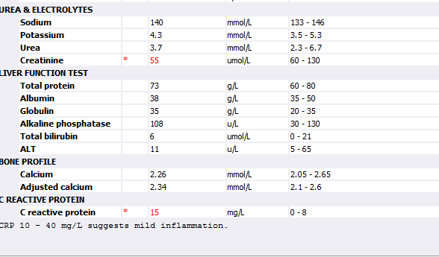
Chemistry blood on admission

Slide 10
What next

Slide 11
Reticulocytes
LDH
DAT
Haematinics
CT chest , neck , abdomen and pelvis
Viral serology
ANA
TFTs
Serum protein electrophoresis

Slide 12
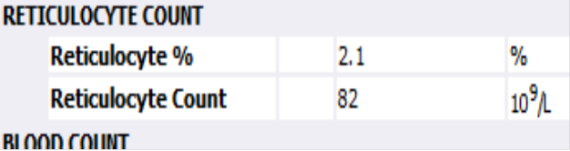

Slide 13
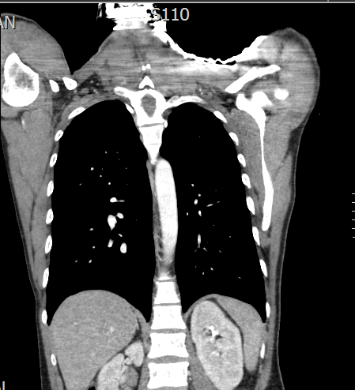
CT CNAP

Slide 14
Next tests

Slide 15
Bone marrow

Slide 16
Bone marrow report

Slide 17
Suggest a diagnosis and treatments

Slide 18
Urgent LB biopsy arranged
IVIG given
Transfuse pools of platelets
Prednisolone 1m/kg started after biopsy
Folic acid
PPI
2 red cell and 1 pools of platelets post biopsy

Slide 19
Flow cytometry and karyotypes

Slide 20
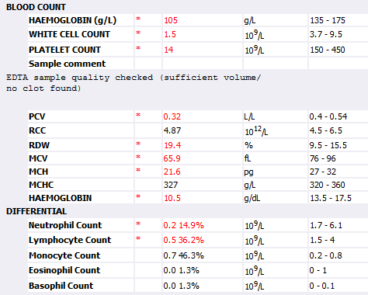
Day 7 of prednisolone

Slide 21
What to do next?

Slide 22
wait

Slide 23
Bloods post IVIG day 3

Slide 24
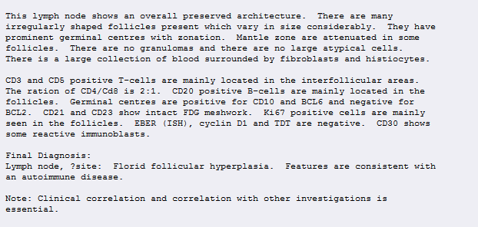
Left axillary node biopsy reports

Slide 25
Further tests

Slide 30
Anti platelets antibody

Slide 31
Anti neutrophils antibody

Slide 32
Endocrinology review
Graves disease likely
Commenced Carbimazole an propranonolol

Slide 33
Further haematology review
Added AZATHIPINE to tapper prednisolone
Indefinite folic acid
Under watch and wait
Euthyroid

Slide 34
Flow of WCC

Slide 35
Blood test January 2017

Slide 36
Diagnosis AILPS most likely
Autoimmune lymphoproliferative syndrome (ALPS) represents a failure of apoptotic mechanisms to maintain lymphocyte homeostasis, permitting accumulation of lymphoid mass and persistence of autoreactive cells that often manifest in childhood with chronic nonmalignant lymphadenopathy, hepatosplenomegaly, and recurring multilineage cytopenias.

Slide 37
ALPS is one of the first well-characterized human genetic diseases of apoptosis. Autosomal dominant transmission of heterozygous germline FAS mutations accounts for the majority of ALPS cases,

Slide 38
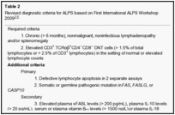

Slide 39
Required criteria
1. Chronic (> 6 months), nonmalignant, noninfectious lymphadenopathy and/or splenomegaly
2. Elevated CD3+ TCRαβ+CD4−CD8− DNT cells (> 1.5% of total lymphocytes or > 2.5% of CD3+ lymphocytes) in the setting of normal or elevated lymphocyte counts
Additional criteria
Primary
1. Defective lymphocyte apoptosis in 2 separate assays
2. Somatic or germline pathogenic mutation in FAS, FASLG, or CASP10

Slide 40
Secondary
3. Elevated plasma sFASL levels (> 200 pg/mL), plasma IL-10 levels (> 20 pg/mL), serum or plasma vitamin B12 levels (> 1500 ng/L) or plasma IL-18 levels > 500 pg/mL
4. Typical immunohistologic findings as reviewed by a hematopathologist
5. Autoimmune cytopenias (hemolytic anemia, thrombocytopenia, or neutropenia) with elevated IgG levels (polyclonal hypergammaglobulinemia)
6. Family history of a nonmalignant/noninfectious lymphoproliferation with or without autoimmunity
Definitive diagnosis: Both required criteria plus one primary accessory criterion.
Probable diagnosis: Both required criteria plus one secondary accessory criterion.

Slide 41
Learning points
Returning traveller from endemic areas can have anything else like other patients
Careful assessment of adenopathy is essential
Any young patient with adenopathy should be evaluated for non cancerous and reactive pathology
EBV lymphoproliferation should be excluded
Autoimmune such as our case

