Slide 1
Haematological Emergencies
A Patients Based Discussion
AMS teaching Day
6th of December 2016

Slide 2
FEW haematology emergencies
Amin Islam
MB, MRCP UK, FRCPath UK
Consultant Haematologist

Slide 3
Patient Based Discussions 1
62 years old man presented to ED
6 weeks history of progressive SOB, being unwell
Had CXR by his GP 1 week ago
NO PMH
NIL medication

Slide 4
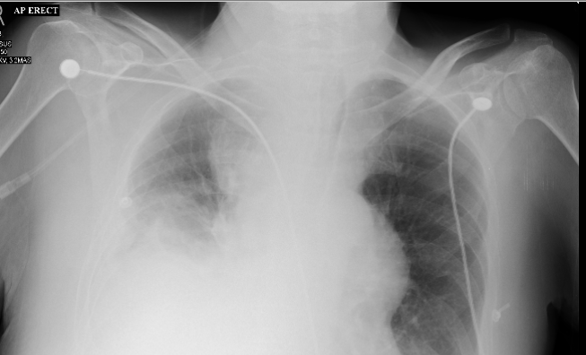
CXR

Slide 5
what is the differentials
Pneumonia
SVCO
Mediastinal mass
Rotated CXR
secondary

Slide 6
What to do next
Bloods
CT CNAP
PET
Viral serology
Arrange biopsy

Slide 7
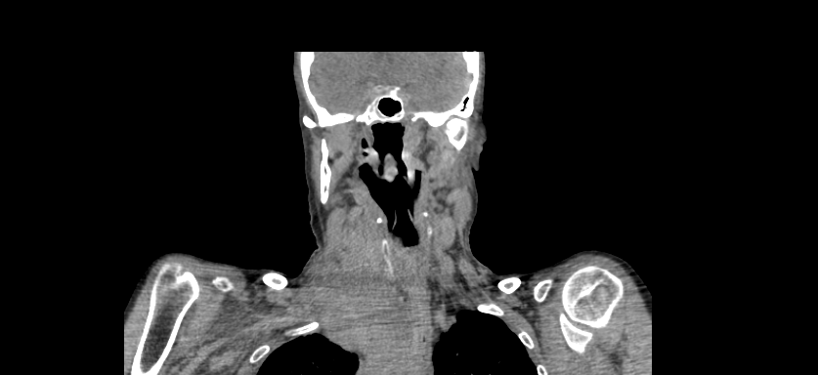
CT CNAP

Slide 8
Svc obstruction
Medical emergency
Multidisciplinary approach
AOS/haematology input
Resuscitations
Early ENT and anaesthetists involvement if necessary
Urgent evaluation for PE concurrently
Urgent biopsy
Consider urgent RT
Commence steroid after biopsy if time allows

Slide 9
treatments
According to diagnosis
Combination chemo immunotherapy

Slide 10
Learning points
Holistic approach and MDT approach
Urgent RT/Steroid life saving
Consider PE as highest risk group

Slide 11
Patients based discussion 2
71 years old man
Presented to ED
3 days history of back pain and leg weakness
Difficulty passing urine for 1 day
No PMH
Only taking PRN paracetamol

Slide 12
What is the differentials
Mechanical back pain
Spinal cord compression
Urinary obstruction due to UTI
Spontaneous fracture of the vertebrae
Other neuropathies

Slide 13
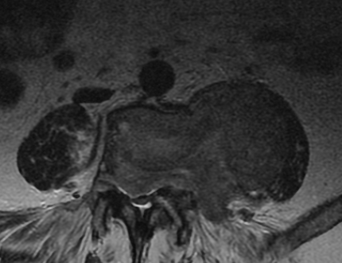
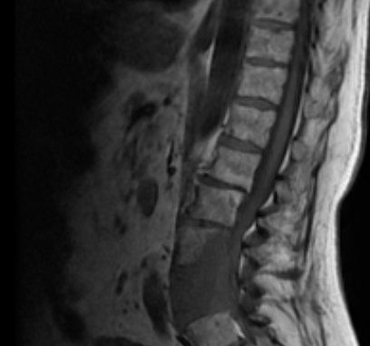
MRI spine

Slide 14
Spinal cord compression SCC
Medical emergency
MDT approach
AOS/Haematology input earliest
Role of urgent RT and steroid are the key
Early assessment and action
Can be reversible if acted within hours
Blood test
May need to look for other primaries by further testing such as CT and specialised blood test

Slide 15
Few important causes
Primary
Myeloma, lymphoma, primary bones
Secondary from other site
Commonly from
Prostate, Lungs ,Thyroid ,Breast

Slide 16
Learning points
Early action can reverse the SCC completely
Late intervention ended up with life long disability
MDT approach
Specialist advise and input ASAP
Look for primary and or secondary's
30% present with NO PAST HISTORY OF CANCER

Slide 17
Patients base discussions 3
56 years old
Presented to ED with 2 days history of cough, easy bruising and lethargy
No PMH
Nil medications
Works as medical pa

Slide 18
Case 3 contd
In ED
Looks unwell
Bruising in legs and arms
BP 80/50, Sats 98% on 2L, temp 38
HB 67, WCC 67, PLT 10, Urea 12, creat 120, alt 12, total bili 20, alp 145, CRP 230
Clotting PT 23, APTT 80, Fibronogen 1,2, TT 34

Slide 19
What is the differential
Acute leukaemia's
DIC
Severe sepsis
Liver failure
TTP

Slide 20
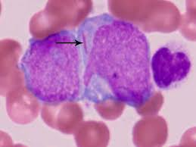
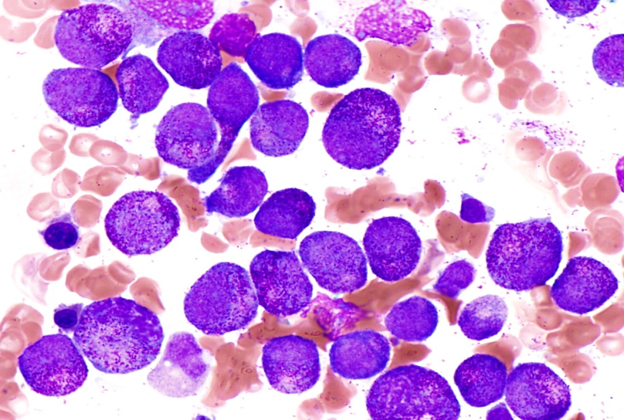
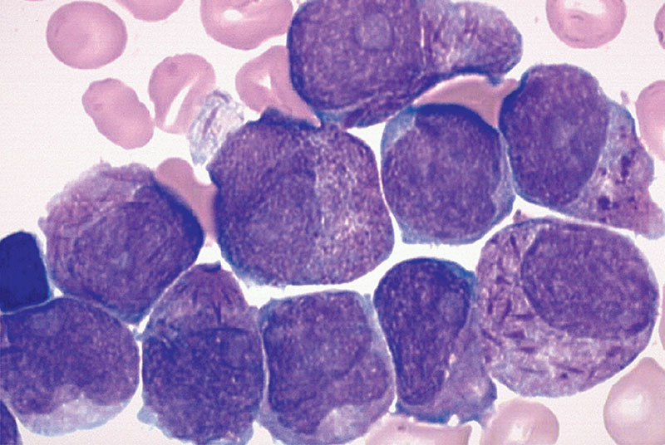
Blood film

Slide 21
(Apml) Acute pro-myelocytic leukaemia
Medical emergency
Urgent Haem input to save life
Correct the clotting ASAP to save life
Transfer to ITU/HDU
Start ATRA and chemo ASAP
transfer to a centre with BSH 2B facility
Completely curable

Slide 22
Learning points
Haem input ASAP
Be Aware of DIC in all Acute leukaemia's
A blood film is life saving
Always do clotting in suspected acute leukaemia's
Always get Haem advise ASAP in suspected leukaemia's

Slide 23
Patients based discussion 4
34 years old lady
Brought in to ED by LAS
Delivered a baby healthy baby 2 weeks ago
Complaining of headache for 4 days
Few bruising in the legs
Dark urine and intermittent fever with dysuria
confused

Slide 24
What is the differentials
UTI post delivery
Severe Sepsis
TTP
Eclampsia
Haemolytic anaemia/Evans syndromes

Slide 25
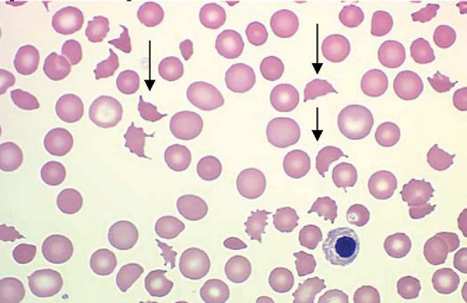
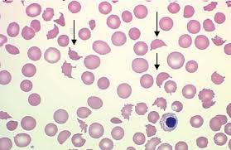
Blood film

Slide 26
Further test
HB 78 WCC 12 Neut 10, PLT 30,retic 10% high
Clotting screen NORMAL
LDH 2300, CRP 120, urea 12 creat 167, total bili 34 alt 23, alp 145, GGT 34,
Bone profiles normal
Virology sent
Ana sent
CT head NAD, CXR NAD
ADMATS13 sent

Slide 27
Ttp (thrombotic thromocytopenic purpura)
Medical emergency
Early assessment and action is of paramount importance
High risk of stroke
Early diagnosis with clinical and blood film pictures
Plasma exchange
If delay then give SD FFP
Triggered by post pregnancy, infection, viral infection, autoimmune process in 30% case only
Role of rituximab and steriod

Slide 28
Learning points
Low threshold to do blood film if not done in lab if suspected
Blood film and clinical diagnosis
Start plasma exchange in suspected case then if ADAMTS13 negative , stop
Any neurological symptoms with low plt think about TTP/HITT/bleeding/clotting

Slide 29
Patients based discussions 5
66 years old patients in SAU
Day 3 post abdominal surgery due to bowel mass
High temperature and cough with green phlegm
Occasional haemoptysis and
Known COPD and type 2 DM
O/E septic patients with oozing from the wounds

Slide 30
What is the differentials
Wound infection
Septicaemia and DIC
Pneumonia
PE
Exacerbations of COPD

Slide 31
Further test sent
HB 85, WCC 20, neutrophils 16, lymph 2.2plt 20
CRP 290, Urea 12, creatinine 100,
LFTs : normal
Full clotting screen: PT 50 APTT 100, Fibronogen 0.5, TT 45
Blood culture sent
CXR NAD only COPD changes , nil new.

Slide 32
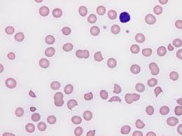
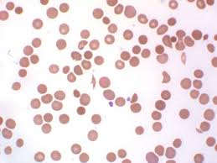
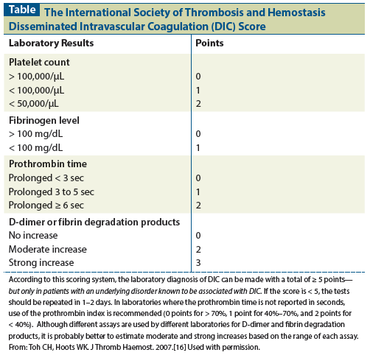

Slide 33
DIC
DIC is always secondary
Treatment of underlying cause
In this case is wound sepsis is likely
Broad spectrum antibiotics essential get micro advise
Correct the clotting
CRYOPRECIPITATE 30MINUTES THAWING TIME
Give PLT only in moderate to severe bleeding
Monitor clotting frequently and give cry/FFP as necessary

Slide 34
DIC
Microthombosis
MAHA
Risk of thrombosis
Some authorities still give iv heparin carefully
Treatment of the cause can reveres the process only
Thrmoprophylaxis early once the bleeding stopped

Slide 35
Few common causes
Severe sepsis
Major trauma
Cancer
Amniotic fluid/fat embolism
Snake bite
Hypothermia
Major surgery and massive transfusions

Slide 36
Learning points
Treat the cause
Give cryoprecipitate not FFP
Give PLT only in active bleeding patient not prophylaxis
Role of novo 7 unknown
Tranexamic acid role unknown in this setting

Slide 37
Patients base discussions 6
Nursing in charge called FY2
67 yrs old patient
Received chemoimmunotherapy 24 hours ago in the ward
Very tired , unable to pass urine
SOB with Sats 78% on ambient air, in AF 110
Normal temperature
Examination: AF, bibasal fine crackles

Slide 38
What is the differentials
Tumour lysis syndrome (TLS)
Severe sepsis post chemo
Pulmonary embolisms
Heart failure secondary to chemotherapy
Chest infections

Slide 39
Further tests
HB 110, WCC 5.6, neut 3.2, PLT 156, lymp 1.2
Na 134, K 6.7,Urea 20, creatinine 490, ALT 34, ALP 120, t bili 15, uric acid 890, PO4 2.8, Mg 2.3
Full clotting : Normal
Calcium 1.67 low.

Slide 40
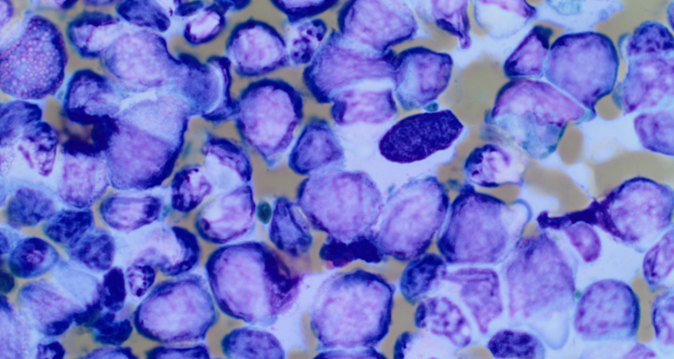
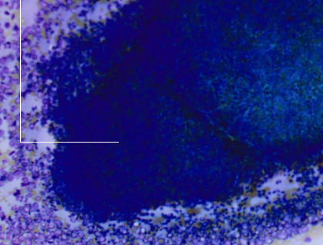

Slide 41
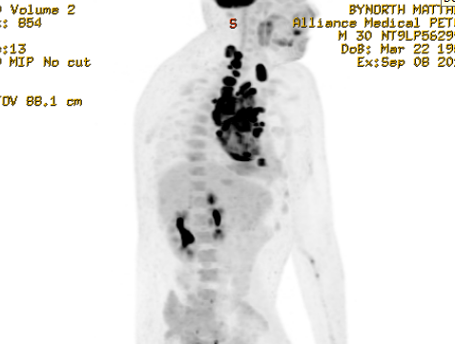
Another example

Slide 42
One more

Slide 43
Tumour lysis syndrome TLS
Medical emergency
Careful patient preparation is the key pre chemo
Blood test at least twice daily
Dialysis and renal in put urgently
Hydration
Rasburicase

Slide 44
Patients based discussion 7
45 years old man
Discharged from AMU Bilateral PE
Seen in anticoagulation clinic early being on LMWH and WARFARIN
Sent TO ED as having bad headache
Diplopia
O/E ED confused, neck stiffness, otherwise
Left leg swelling and redness
Haemodynamic ally stable

Slide 45
bloods
HB 123, WCC 5.6 Neut 4.4 PLT 25, CRP 12,
Other biochemistry NORMAL
Clotting screen , INR 1.2 APTT 34 Fibrongen 5.8
Intracranial bleeding secondary to Anticoagulation

Slide 46
differentails
Menigitis ?viral
Sepsis
HITT and
new DVT

Slide 47
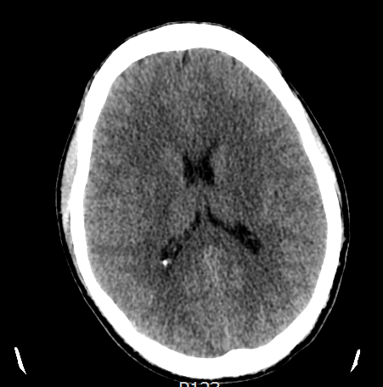
CT head

Slide 48
questions

Slide 49
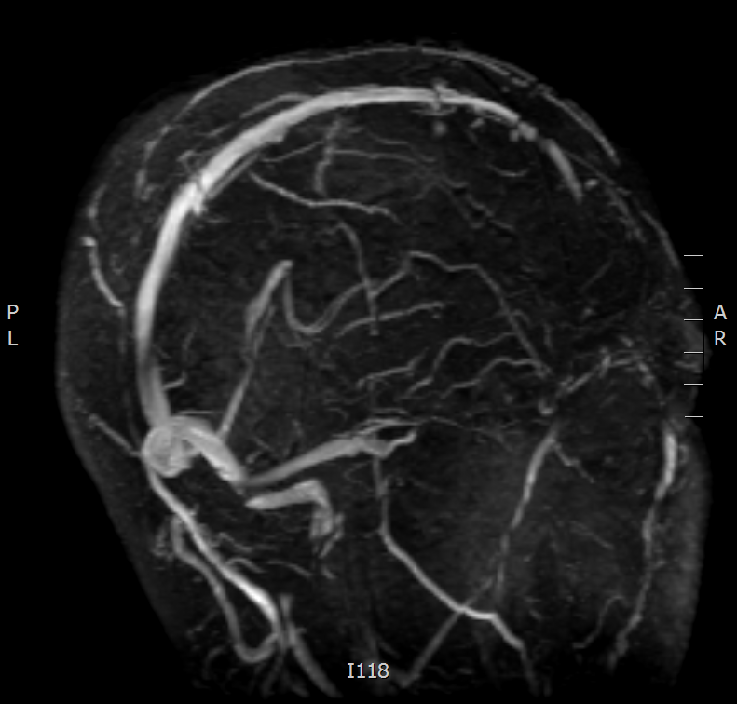
MRV

Slide 50
HITT
Medical emergency
HITT score urgent
Stopped LMWH
Send the HITT screen Filton Bristol vial lab
Start alternative anticoagulation
We start Direct thrombin inhibitors ARGATROBAN IN SUHFT
Target APTR 1.5 -3.0
Start WARFARIN once the PLT normal for 48 hours

Slide 51
HITT score system
0 to 3 points: | Low probability
4 to 5 points: | Intermediate probability
6 to 8 points: | High probability

